Slide 1

Web Games: Advancing the Magic
June 26, 2019

Slide 2


I ❤️ the Web
Notes:
Hey Everyone,
My name is David Catuhe…I work at Microsoft on an open source platform called Babylon.js…..and one thing you should know about me….I absolutely LOVE the web. I have been developing on the web for XX years and have stayed in this space because I am passionately driven by the possibilities inherit in this platform.
We’re here to talk about the web, but specifically, gaming on the web, and this is another huge passion of mine. In fact the intersection of these two things is why I created Babylon in the first place. We have come SOOO far in the types of games that are possible to make on the web.

Slide 3
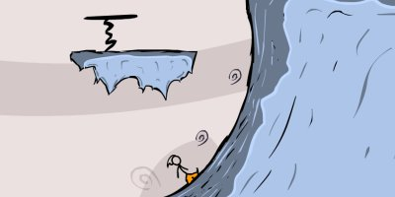
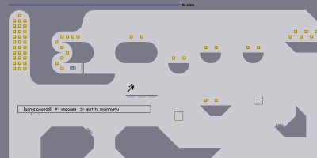
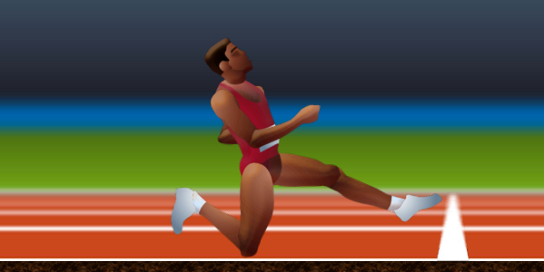


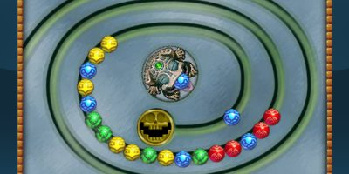
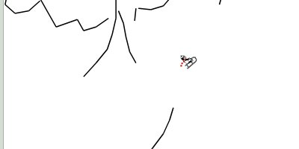
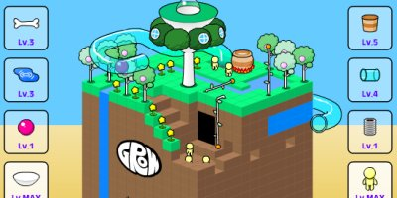

Notes:
Just 10 years ago, games were flash driven and while the developers and artists were able to create some truly memorable and fun moments to us, technology was letting them down. They had to create games with limited technical resources available to them.

Slide 4
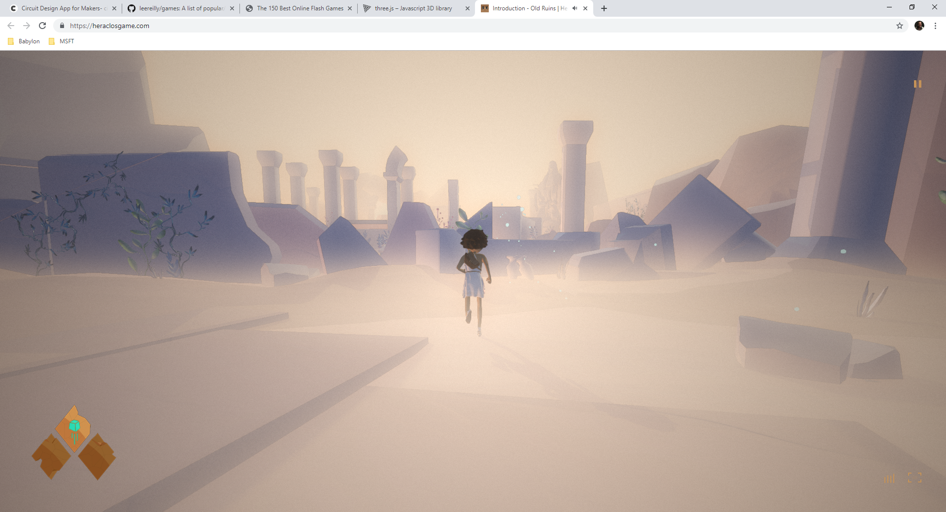
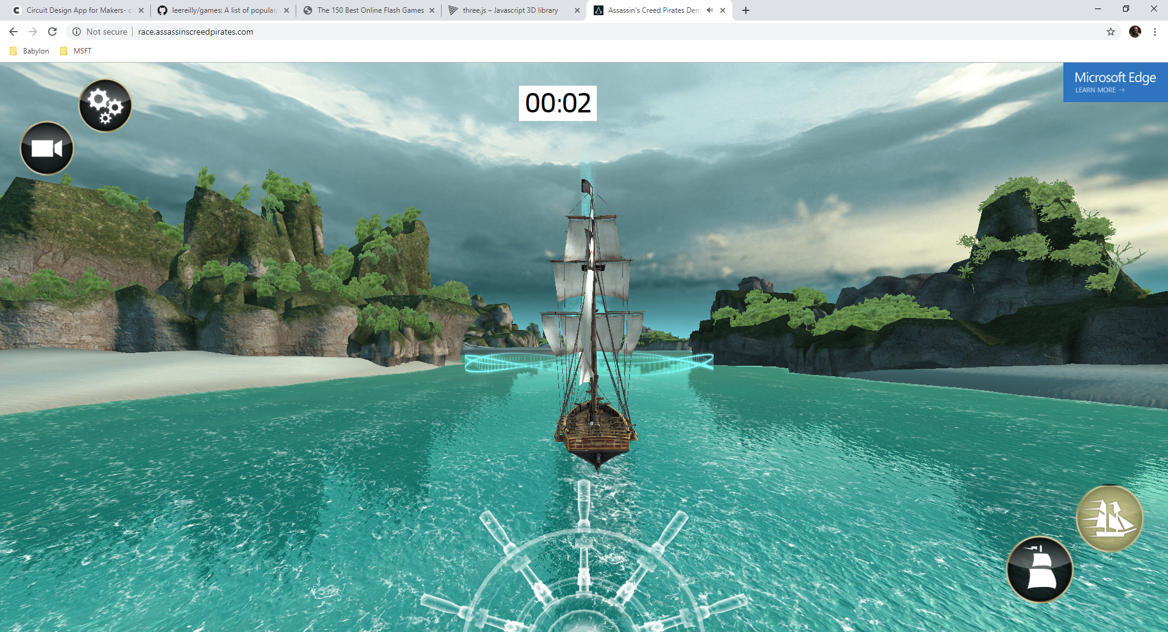
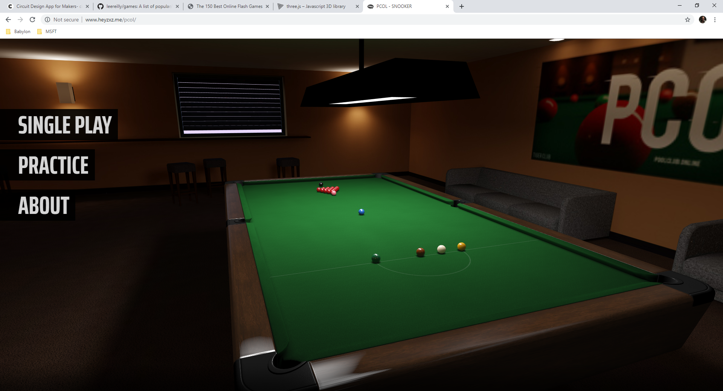
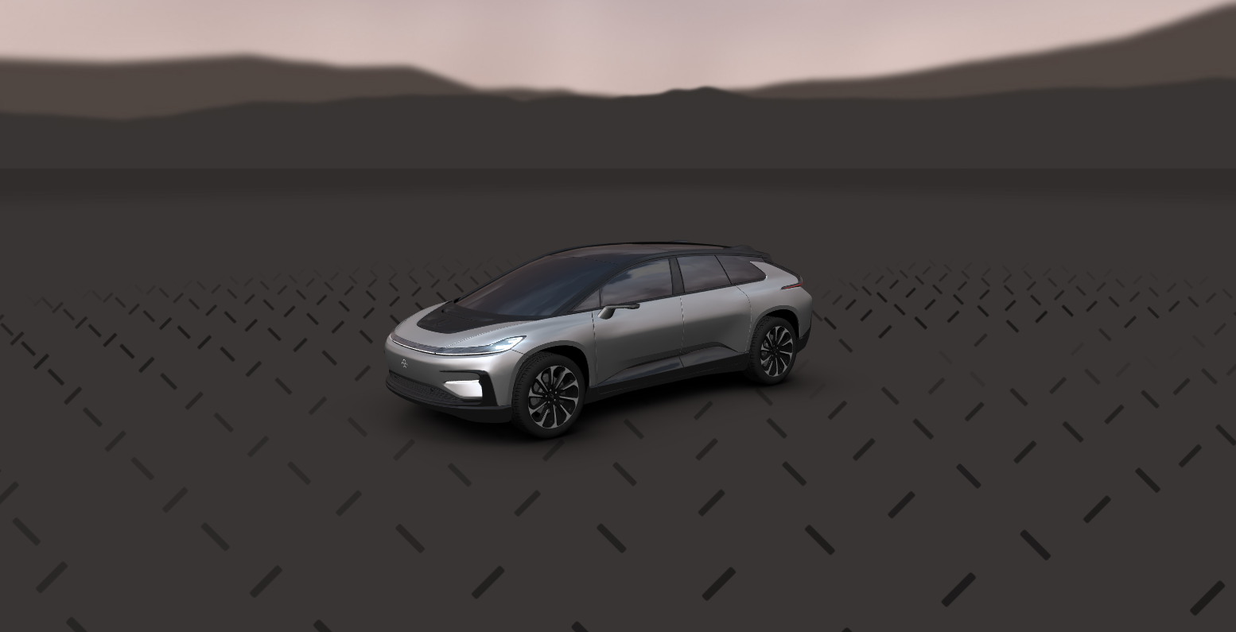
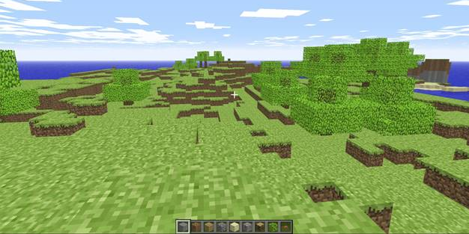
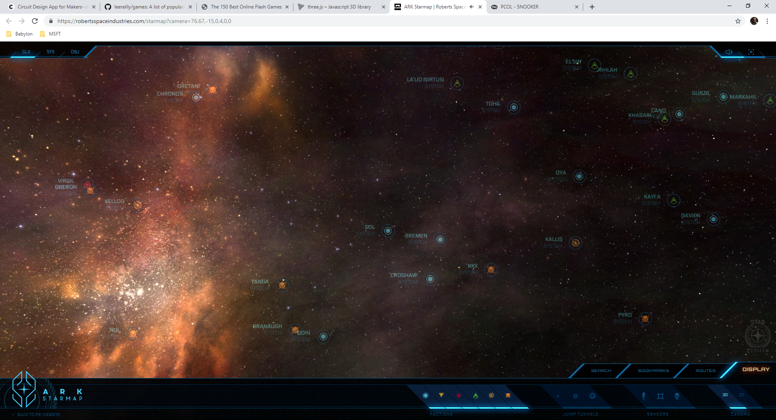
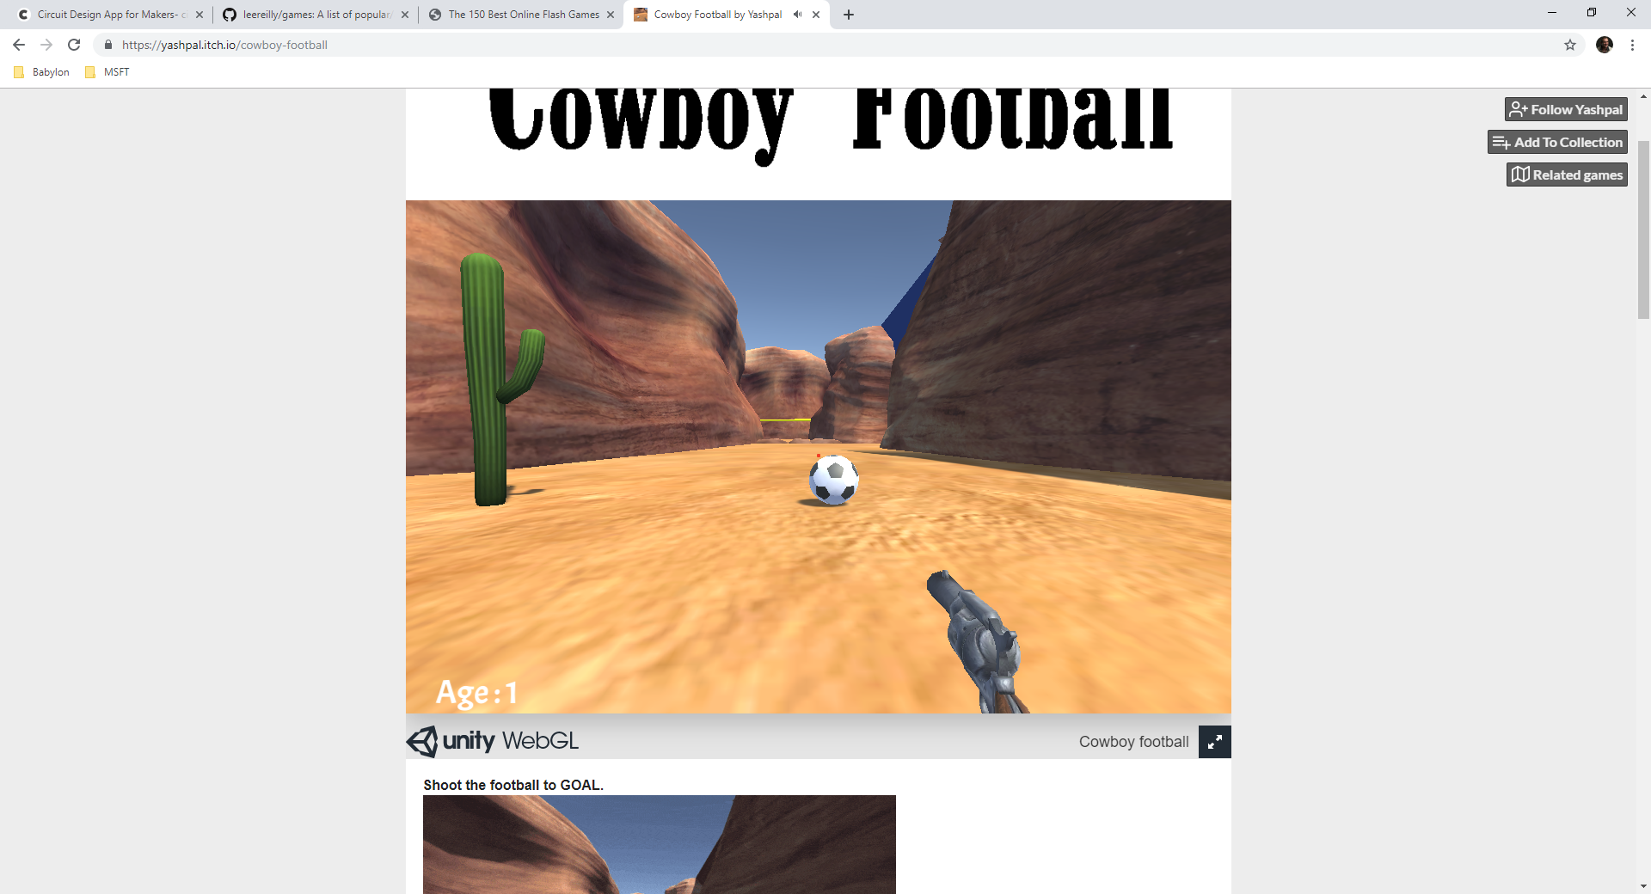
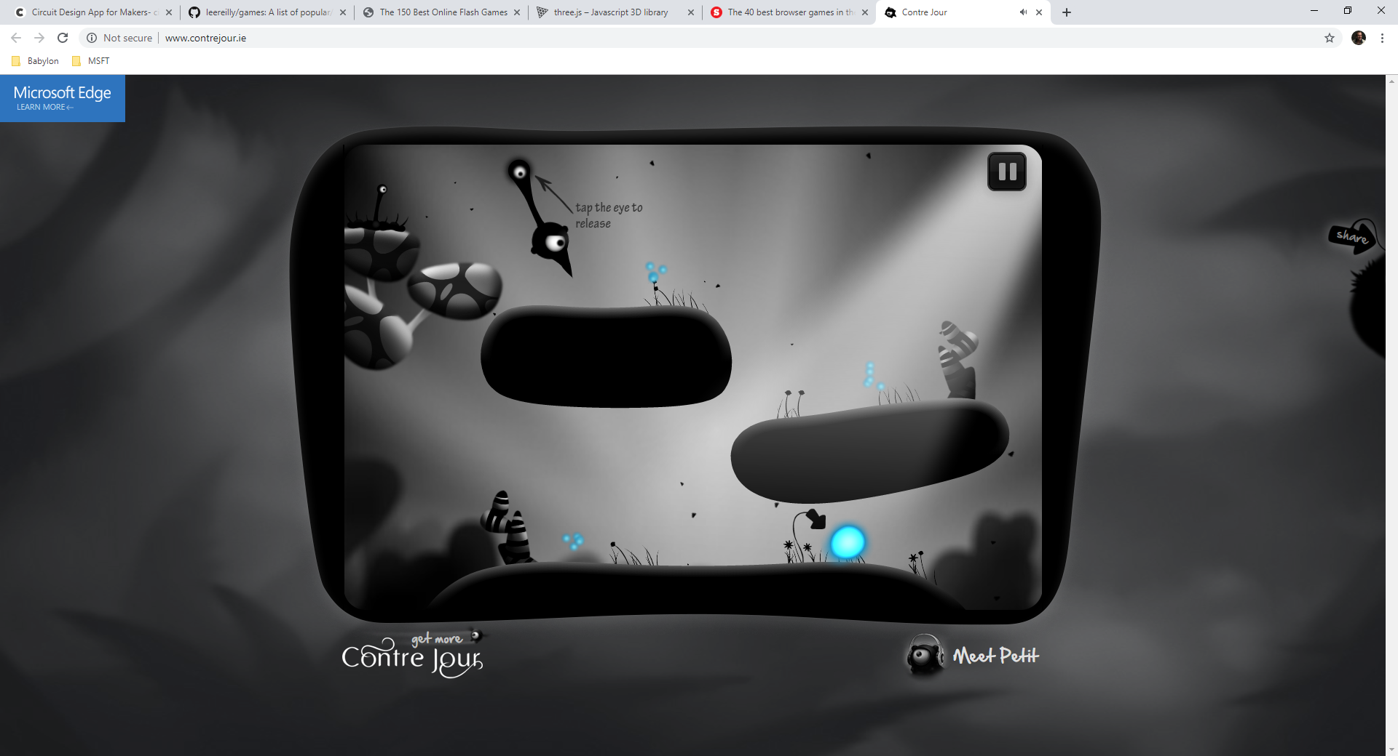
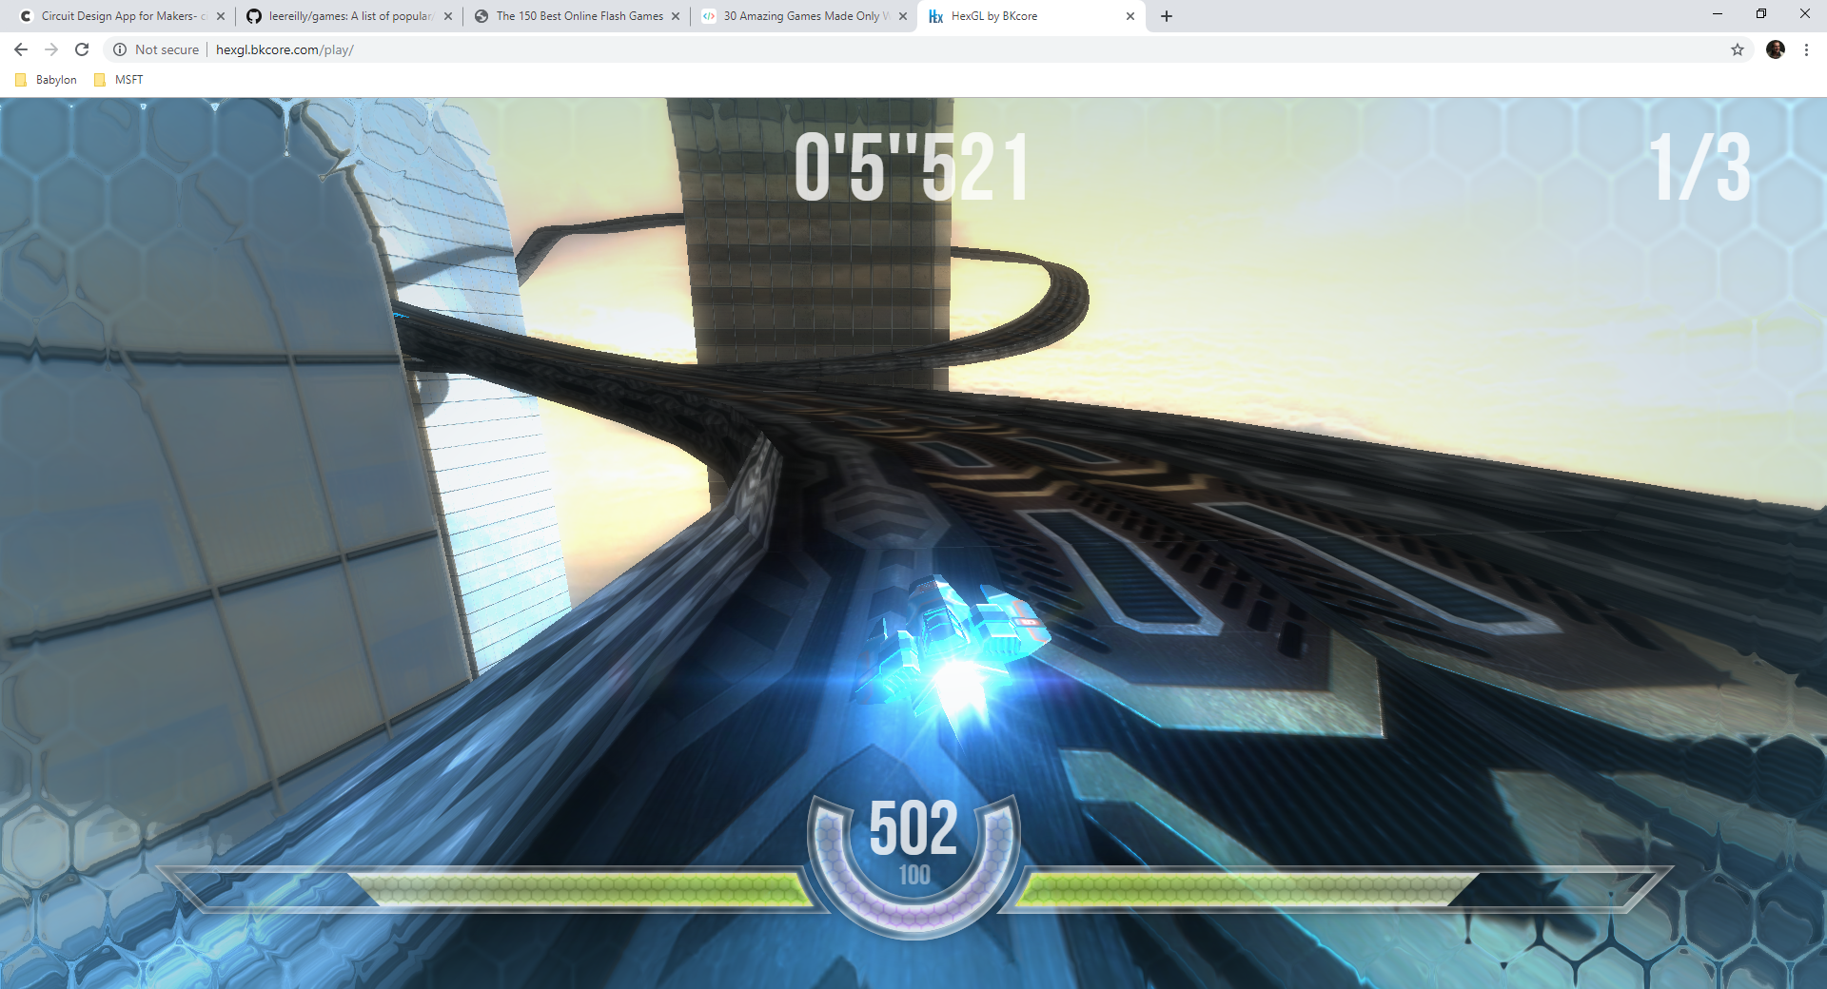
Notes:
Since then we’ve worked together to bring incredible power, performance, and tools to game developers everywhere. Today we’re able to render complex and amazingly beautiful worlds all inside of the browser. But there is still so much more that we have to do.

Slide 5
I ❤️ the Web
Notes:
I love the web. It’s true. But

Slide 6
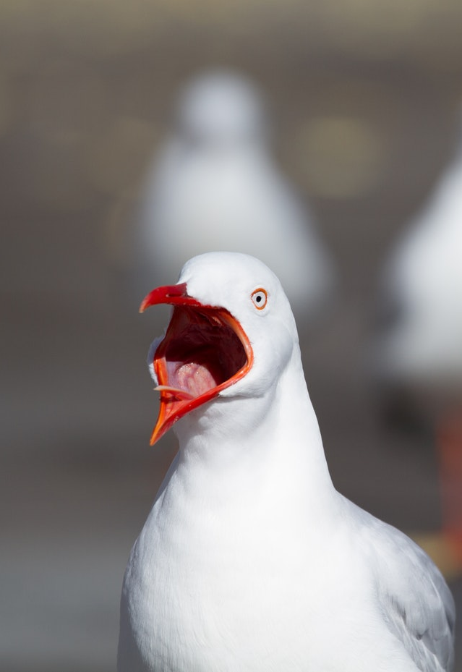
Notes:
The web also FRUSTRATES ME!!!!! We have come so far, but we still have so far to go! It is this love of the web and frustration with it that drives me to make it better…every day.
And I bet it’s the same for all of you. You are here because you care, because you want the web to be the best that it can be. We are all here to make games on the web, faster, more beautiful, and truly competitive with native experiences.

Slide 7
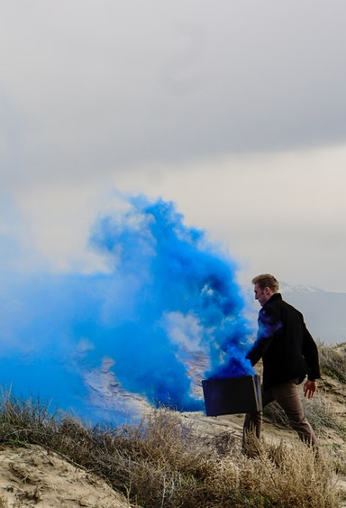


Some of The Topics We’ll Cover:
Asset Management
Performance
Cloud Support
Notes:
Throughout this conference we’re going to focus on 3 key areas where we can channel our collective passion and work together to make the web better for games.

Slide 8

Asset Management
IP Protection

Slide 9

Asset Management
File Size

Slide 10

Asset Management
Compression

Slide 11

Performance
WebGPU

Slide 12

Performance
Threading

Slide 13

Performance
Web Assembly

Slide 14

Cloud Support
New Codecs

Slide 15

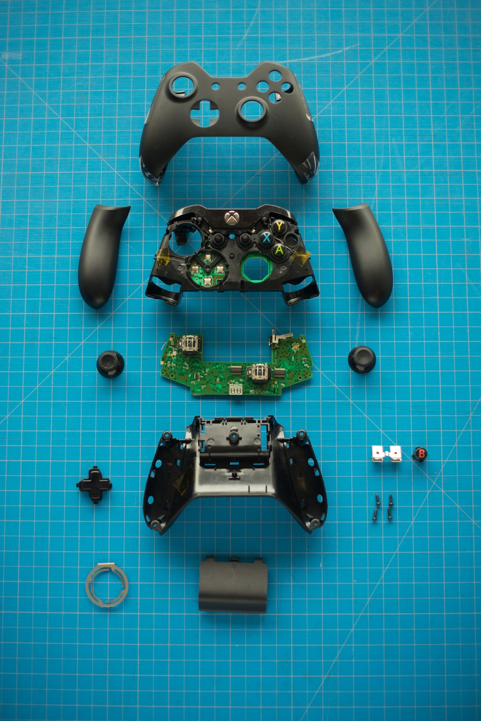
Cloud Support
GamePad Support

Slide 16

Cloud Support
Latency Control

Slide 17

Let’s Go Change The Web
Notes:
So enjoy the next 2 days. Attend as many talks as you can. Let’s change the web together!
Thank you

